Slide 1
Comparative analysis of news articles on climate change
Instructor: Rong Liu
BIA660-A – Web Mining
Group 11
Aditya Gaikwad
Hanish Pallapothu
Moneka Ruhiil
Rishab Agrawal

Slide 2
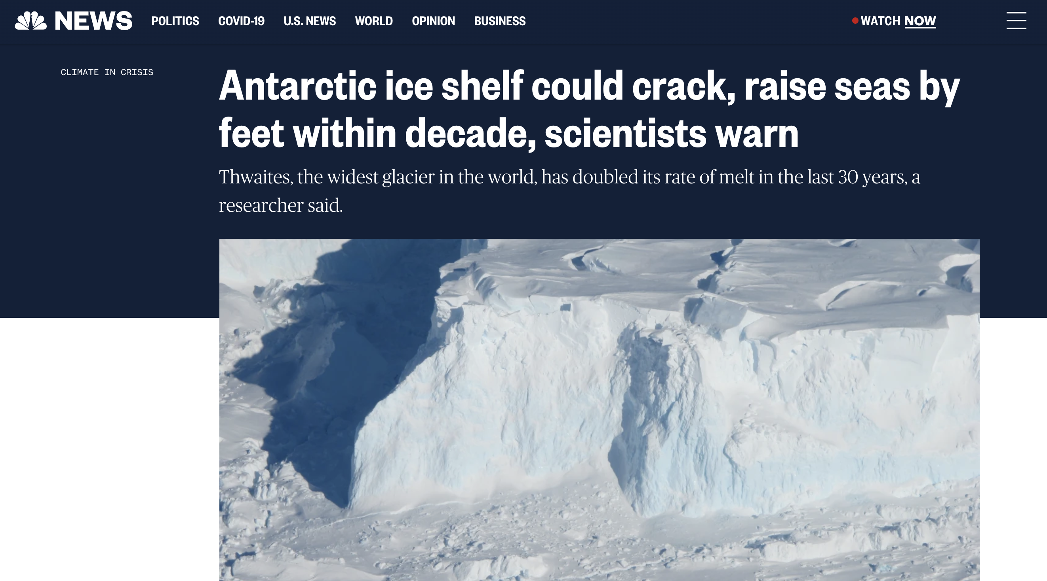
Introduction
Goal of the project: To create clusters in order to compare news articles related to climate change from various countries.
To create clusters for climate news articles from various countries.
Analyze the articles in each cluster of news from two different countries.
Sample Climate Change News article from NBC News

Slide 3
Project Workflow
Data collection through scrape
Data pre-processing
EDA
Clustering
Evaluation
Analysis of Experiment results

Slide 4
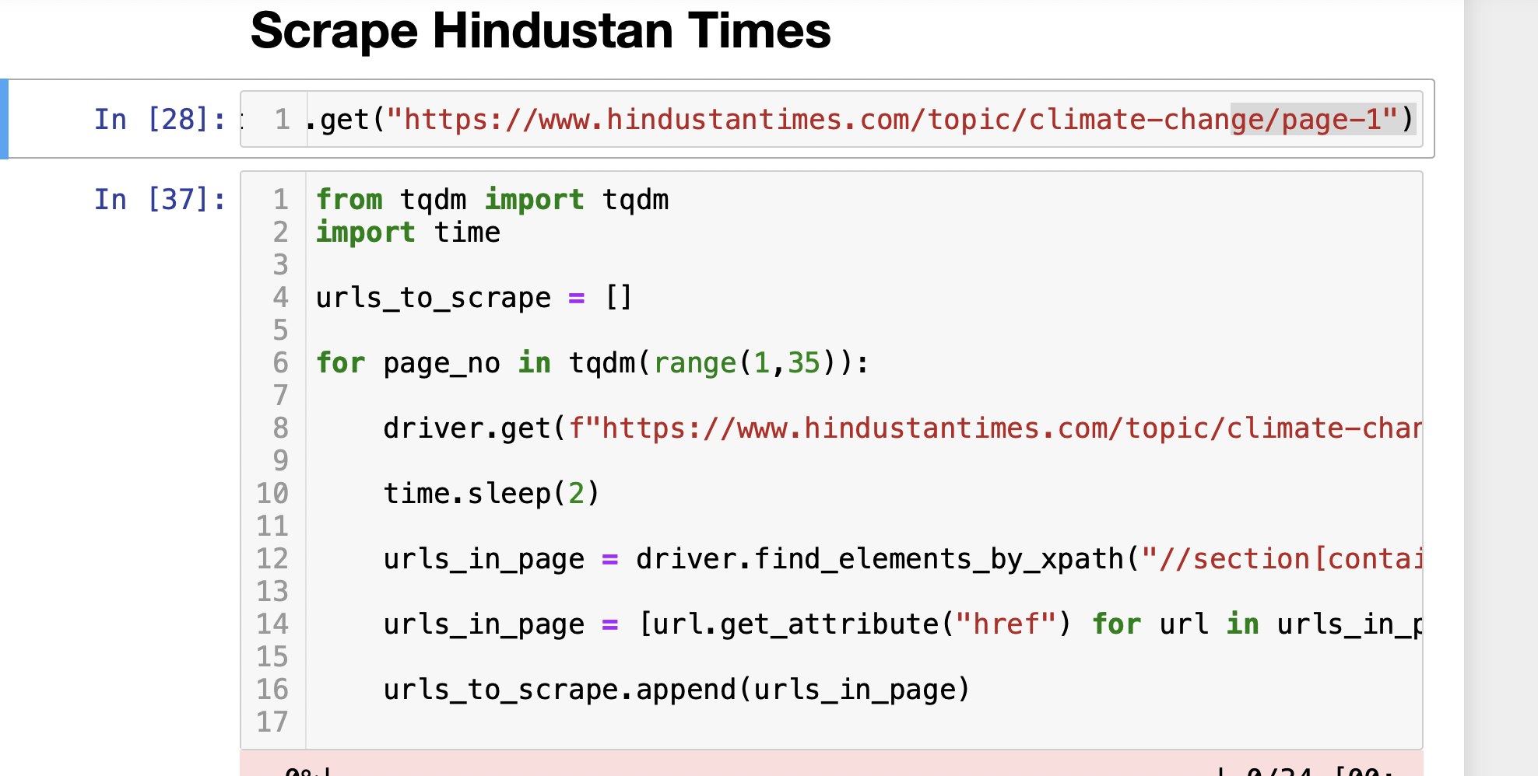
Web Scraping
Scraping the 1000 articles texts on climate change including title and description
From Indian and American websites and store the data into a file using selenium

Slide 5
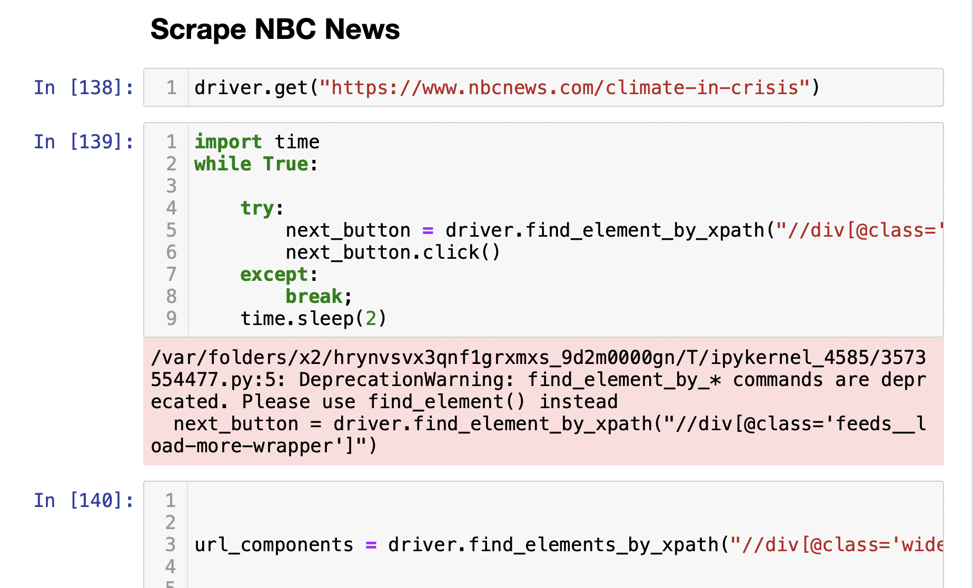
Web Scraping

Slide 6
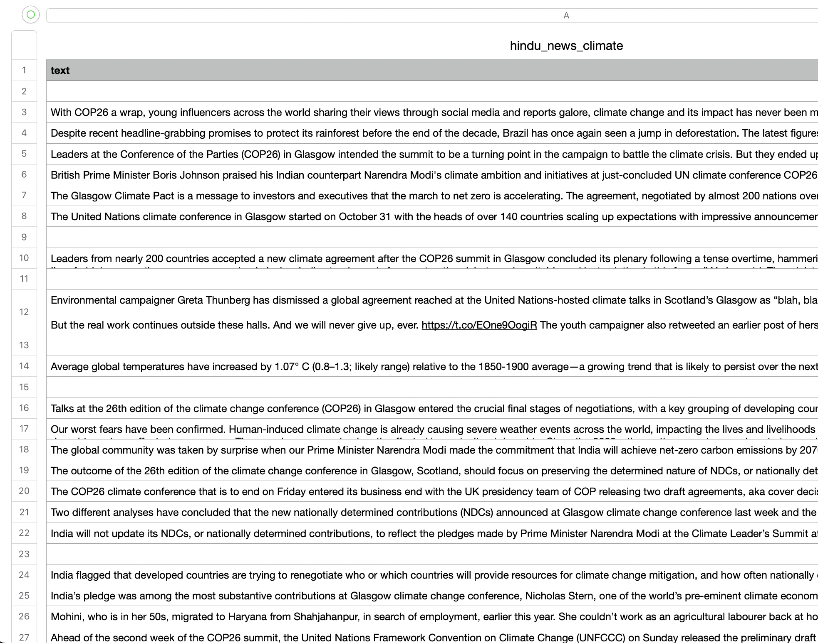
Scrapped data from Indian Website

Slide 7
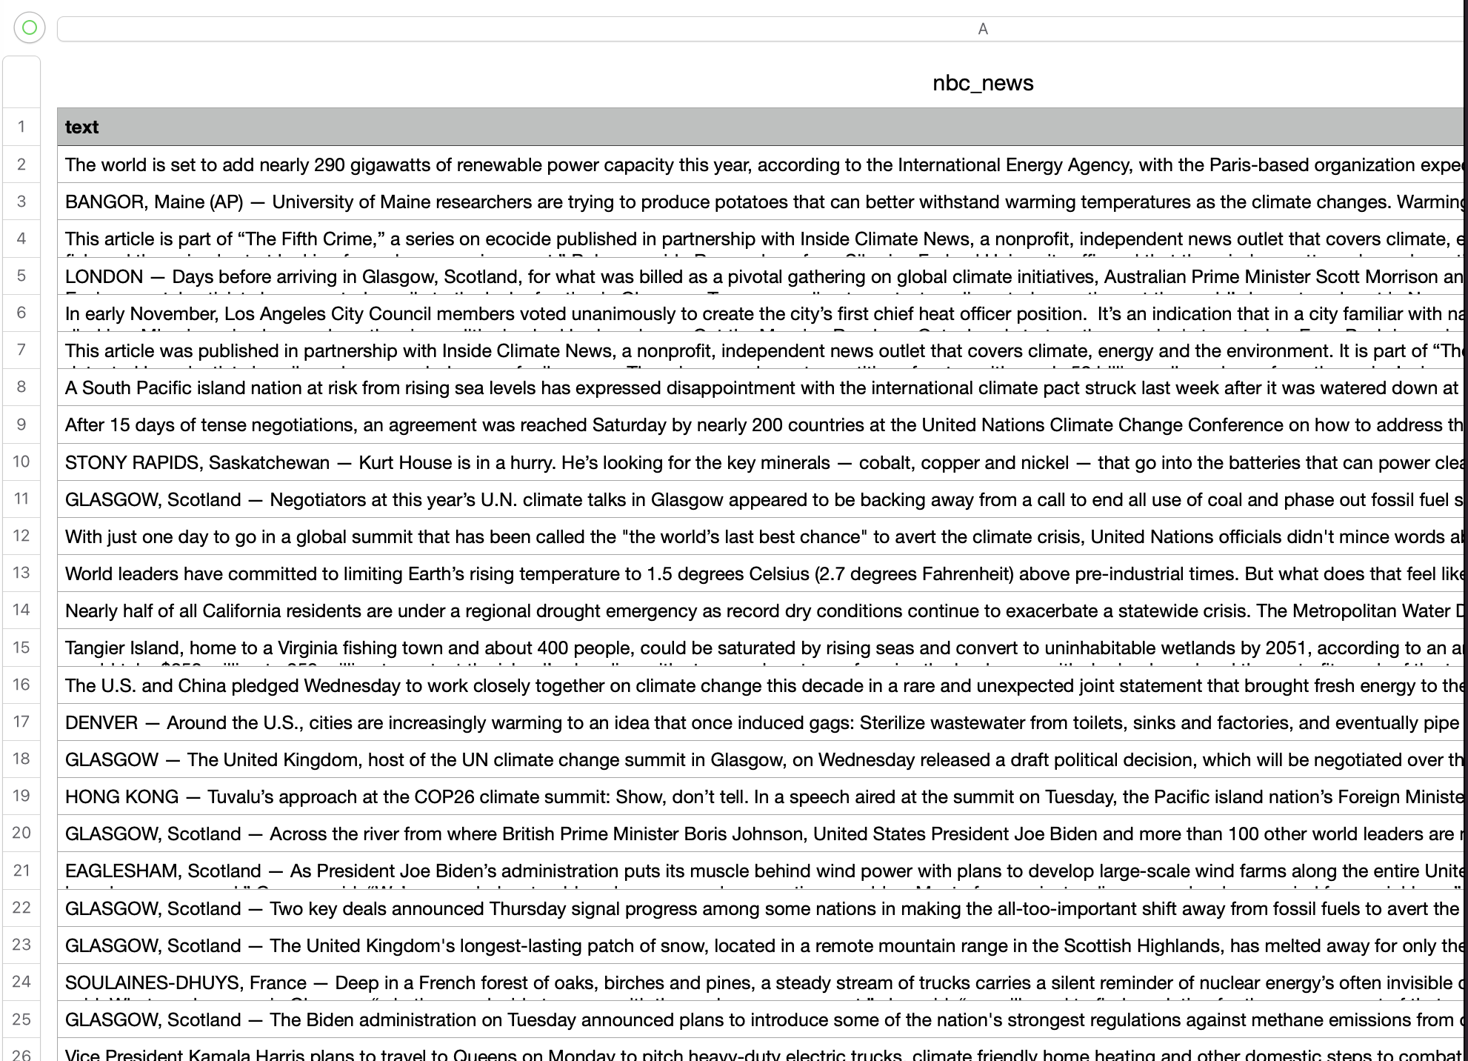
Scrapped data from American Website

Slide 8
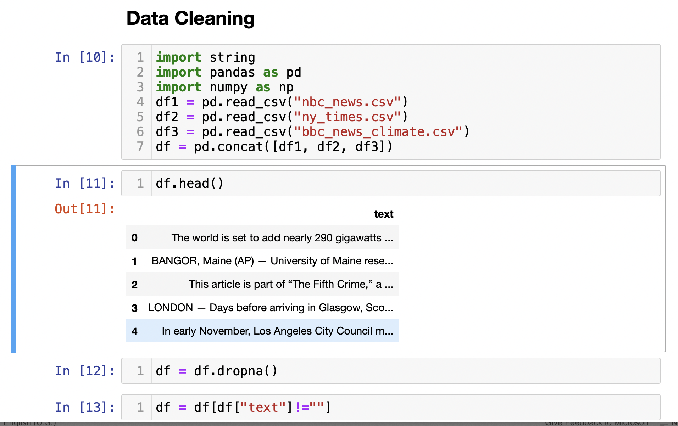
Data Pre-processing
Combine the all website data of American news in a data frame

Slide 9
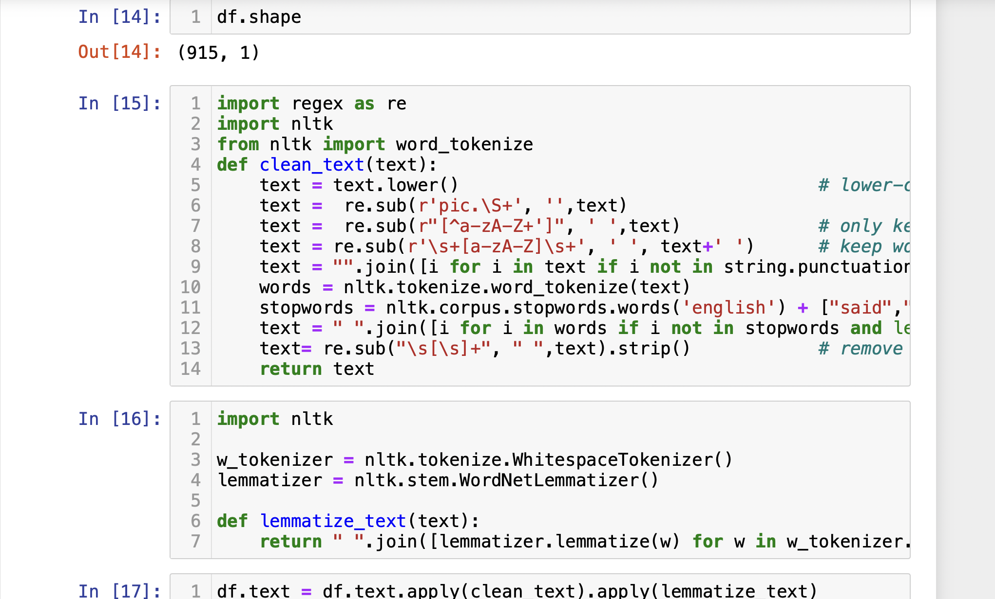
Data Pre-processing
Clean up text using Regex and NLTK library, remove all punctuation, stopwords and special words like news, government and space from text and lower case all text

Slide 10
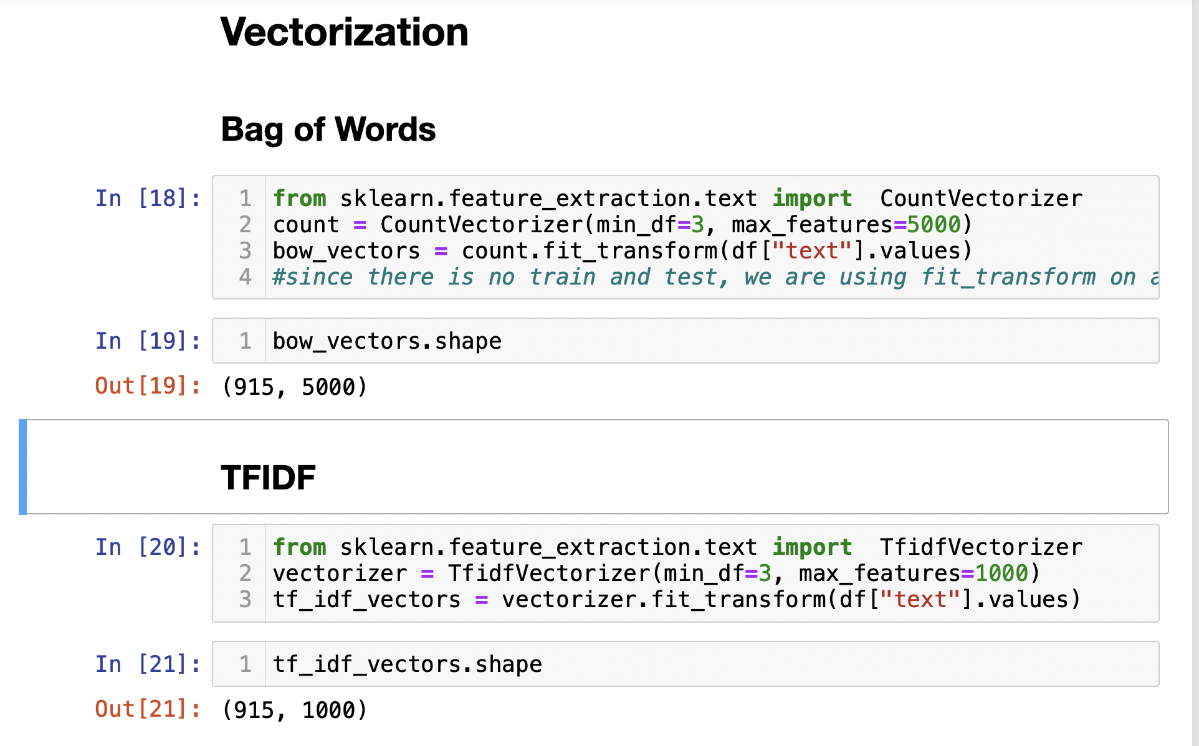
Vectorization
For American Newspaper

Slide 11
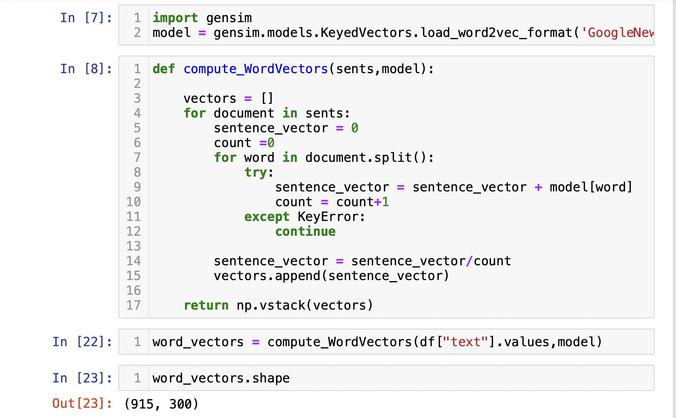
Vectorization

Slide 12
Clustering
No labels for the matched activities- Unsupervised learning
Used four clustering methods
K means clustering – Centroid model
GMM(Gaussian mixture model)
Agglomerative clustering – Connectivity model\
DBSCAN (Density-Based Spatial Clustering of Applications with Noise
K-Means clustering
It is a partitioning algorithm - partitions dataset into as number of clusters to
Minimize intra-partition distances
Starts with a first group of randomly selected centroids, which are used as the
beginning points for every cluster
Performs iterative (repetitive) calculations to optimize the positions of the centroids
Library – sklearn.cluster import Kmeans

Slide 13
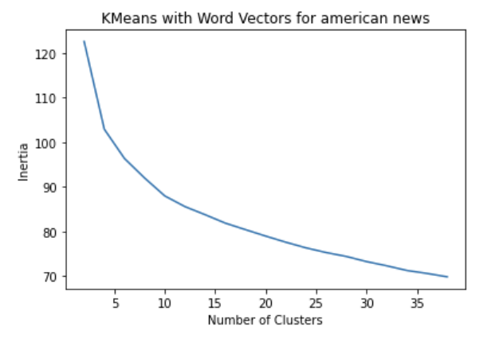
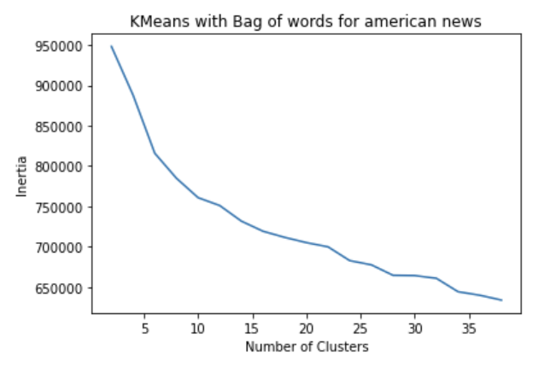
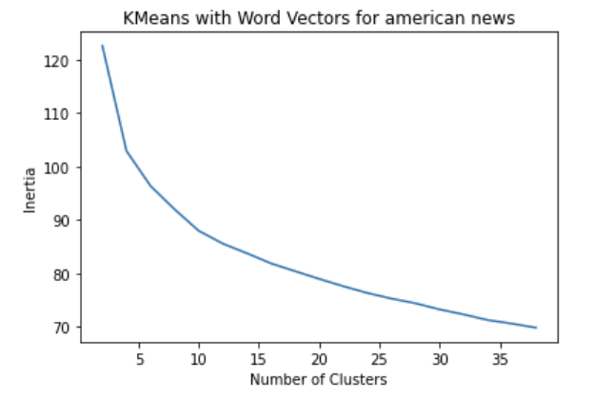
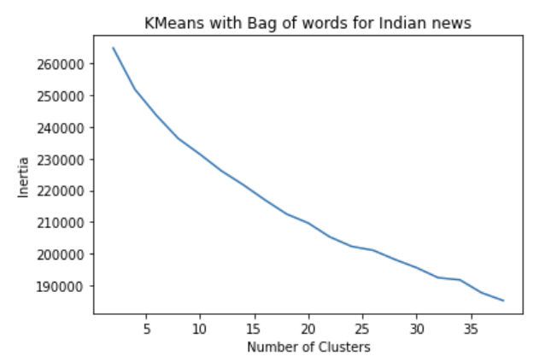
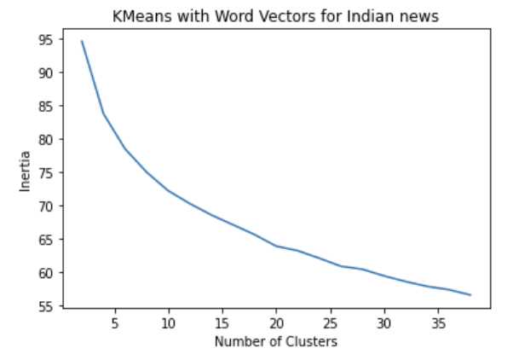
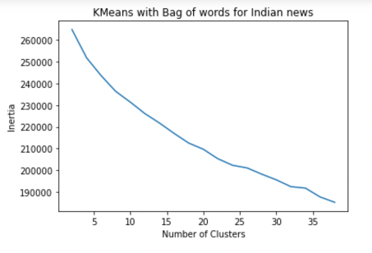
K Means Comparative Analysis
With Bag of words technique,TF-IDF and Word2Vec
We get value of k as 8 for both American news and Indian news according to this for bag of words vectorizer
The same way we get clusters as 9 and 6 for Indian news and American news in case of TF-IDF vectorizer
We get clusters as 4 and 4 for Indian news and American news in case of Word2Vec.

Slide 14
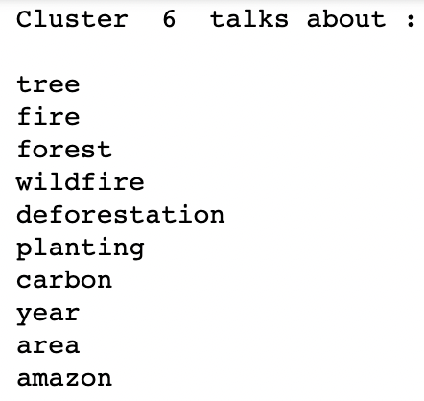
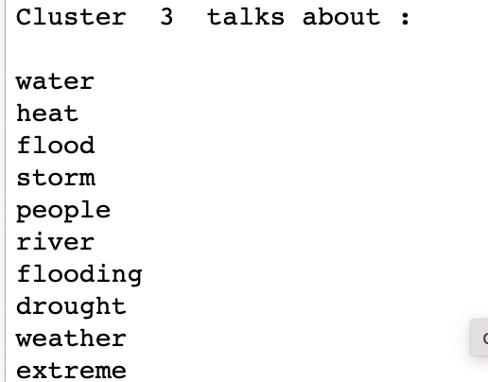
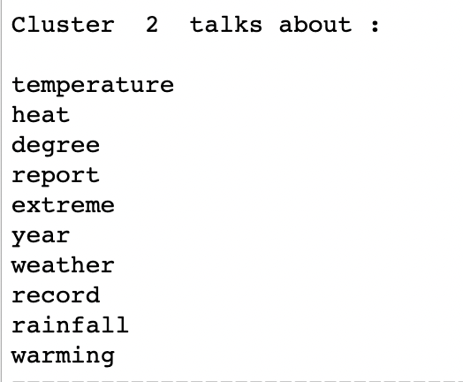
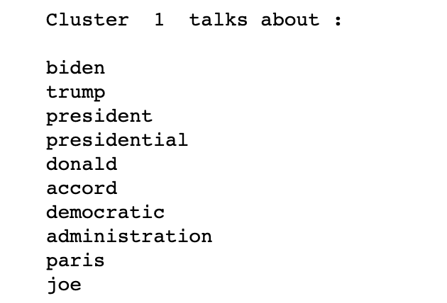
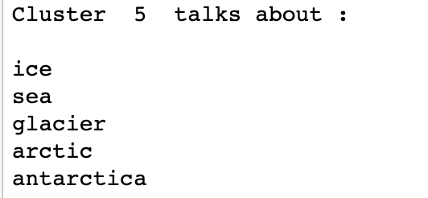
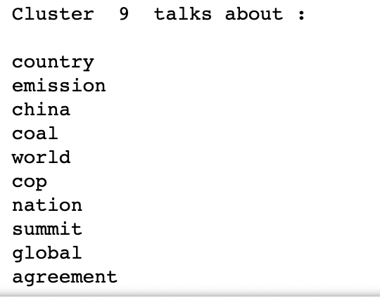
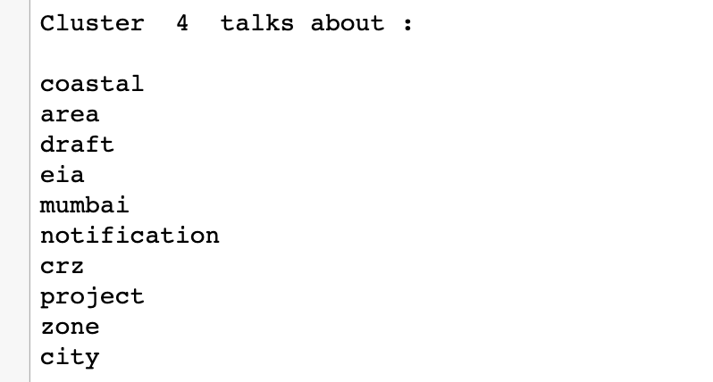
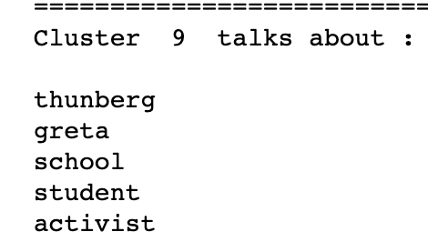
K Means Comparative Analysis cont...
Indian News American News

Slide 15
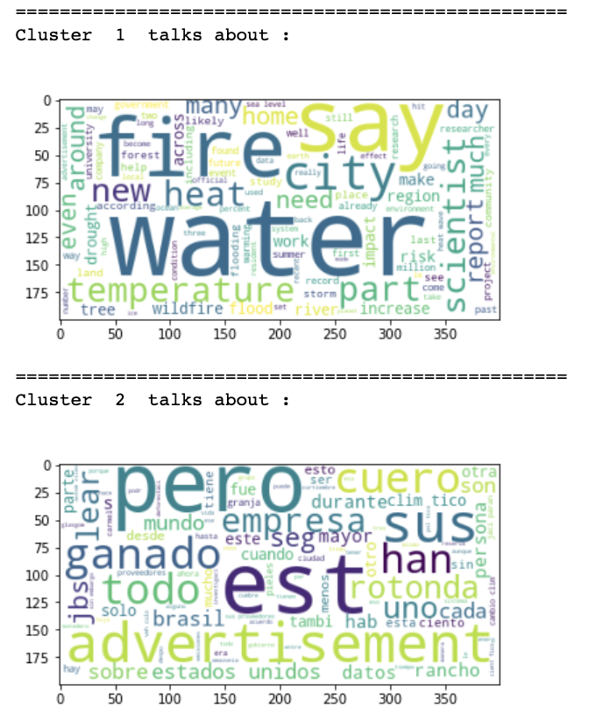
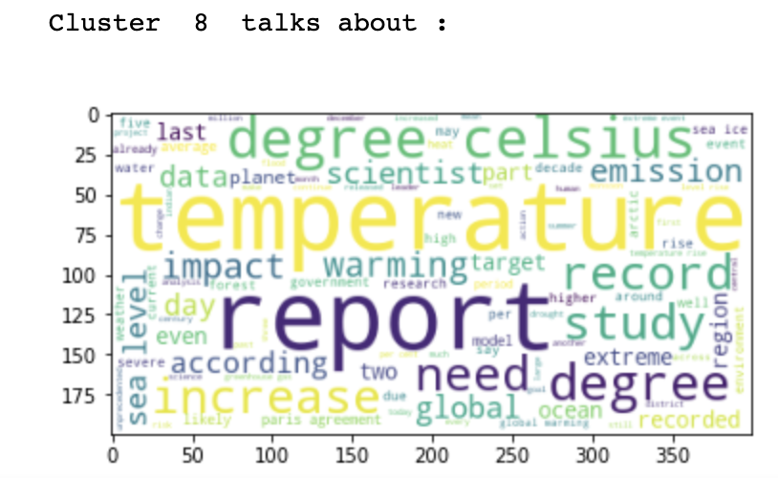
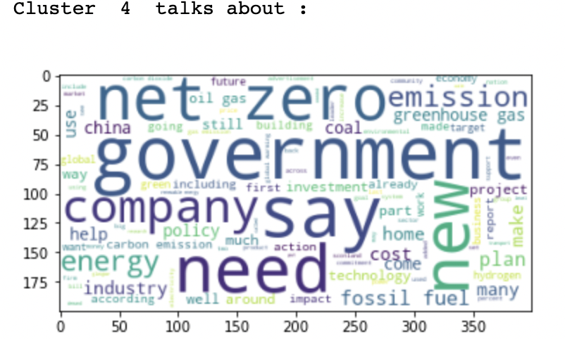
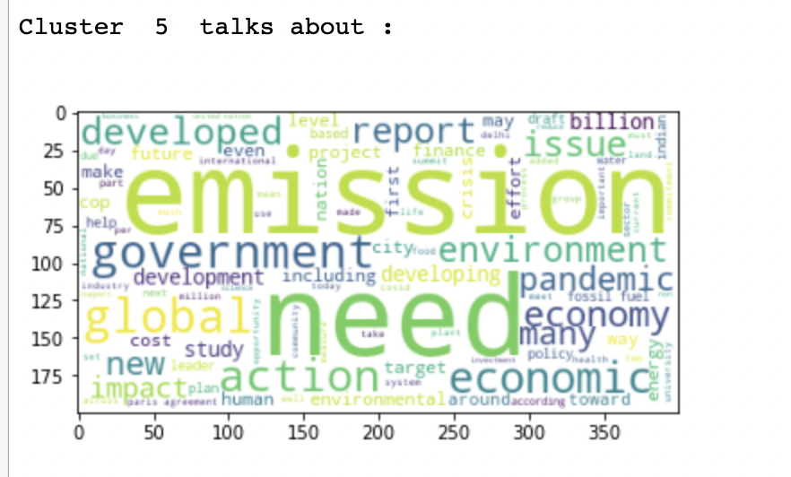
K Means Comparative Analysis cont...
American News Indian News

Slide 16
GMM Comparative Analysis
To estimate the parameters of a Gaussian mixture distribution.
We used Bag of words, TF-IDF and Word Vector methods with GMM models.
We performed comparative analysis between Indian and American Newspaper
Library – sklearn.misture import GaussianMixture
Results:
1. We found the best BIC having 9 number of clusters for Indian news news and 7 for American news in case of Bag of Words.
2. We found the best BIC having 9 number of clusters for Indian news and 9 for American news in case of TF-IDF vectorizer .
3. We found the best BIC having 9 number of clusters for Indian news and 4 for American news in case of Word2Vec vectorizer .

Slide 17
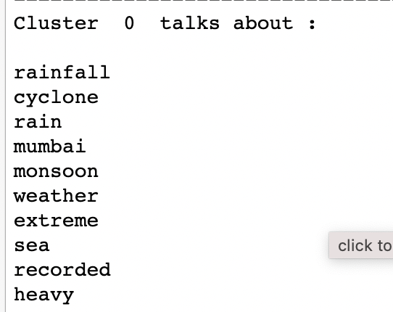
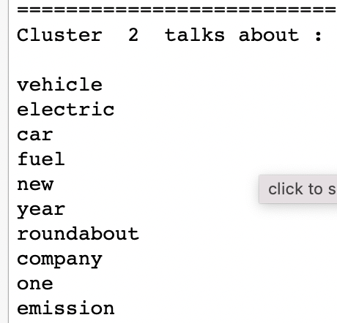
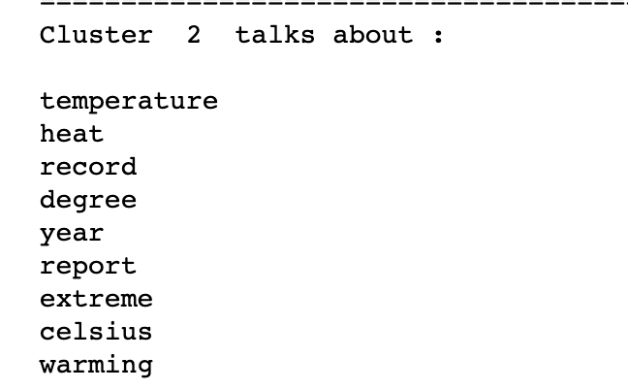
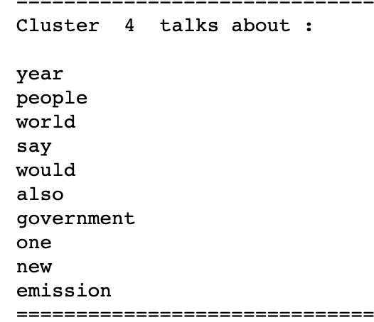
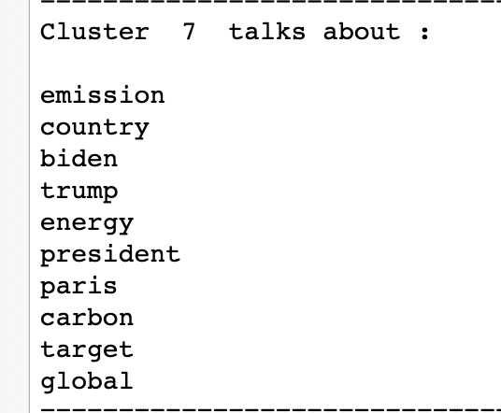
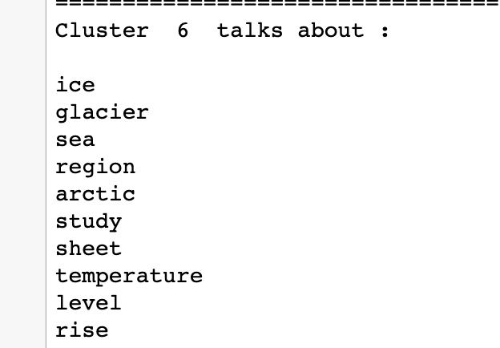
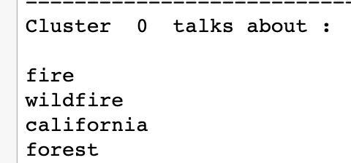
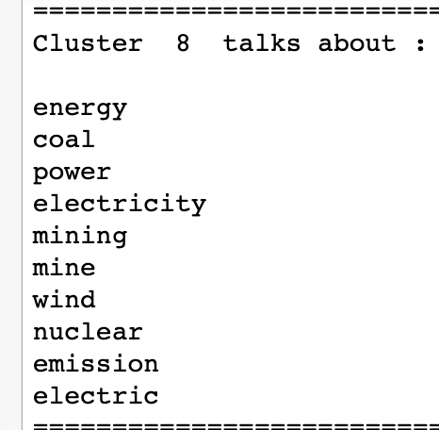
GMM Comparative Analysis cont...
Indian News American News

Slide 18
Agglomerative Clustering
Each data point is considered as a individual cluster in this method.
At each iteration, the similar clusters merge with other clusters until K
clusters are formed.
Library - from sklearn.cluster import AgglomerativeClustering
For Agglomerative clustering we have created an elbow graph using cluster value 2 to 30 using a visualizer yellowbrick package
Using agglomerative clustering we found 10 number of clusters for Indian news and 9 for American news in case of Word2Vec vectorizer. The above images are for Indian news and American news for some cluster images as well as elbow method graph.

Slide 19
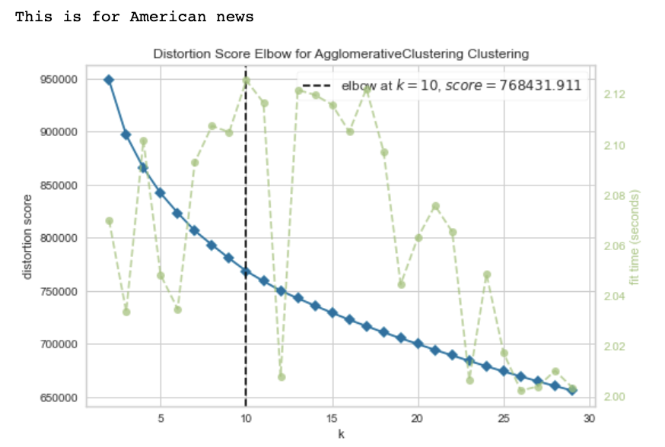
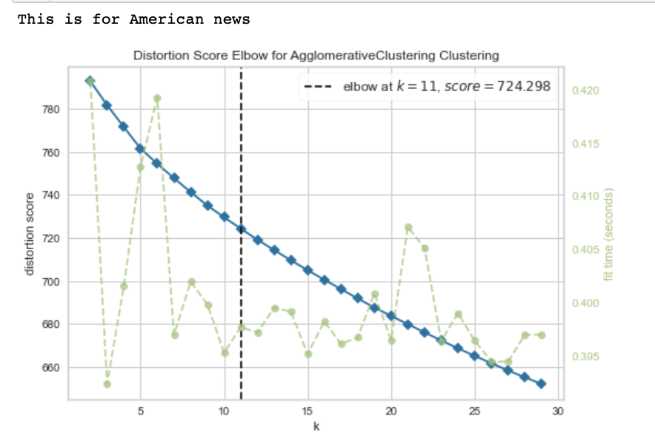
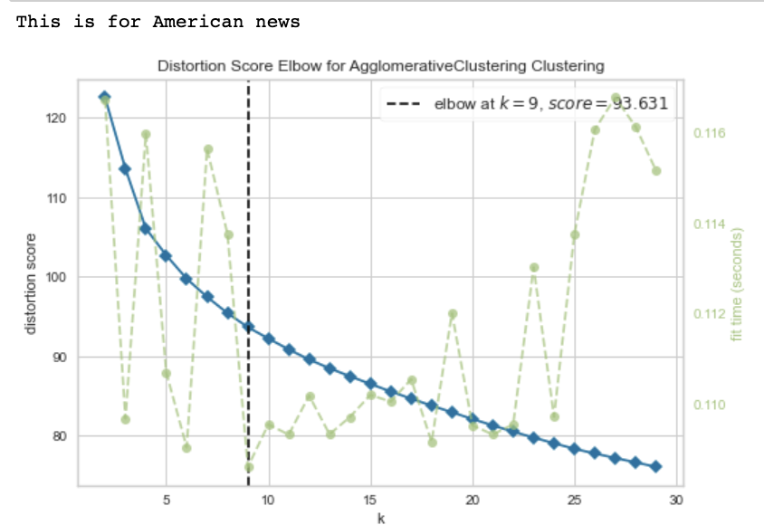
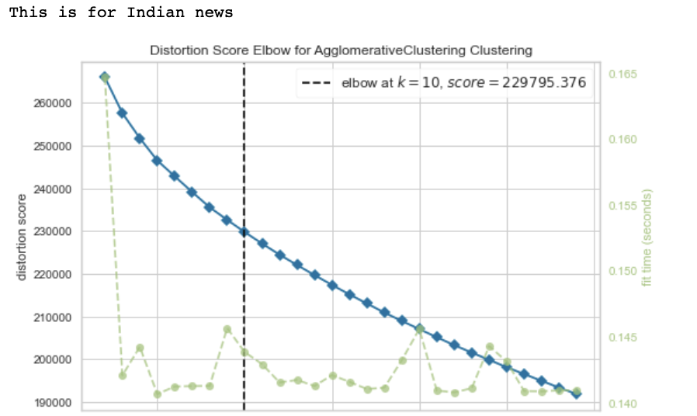
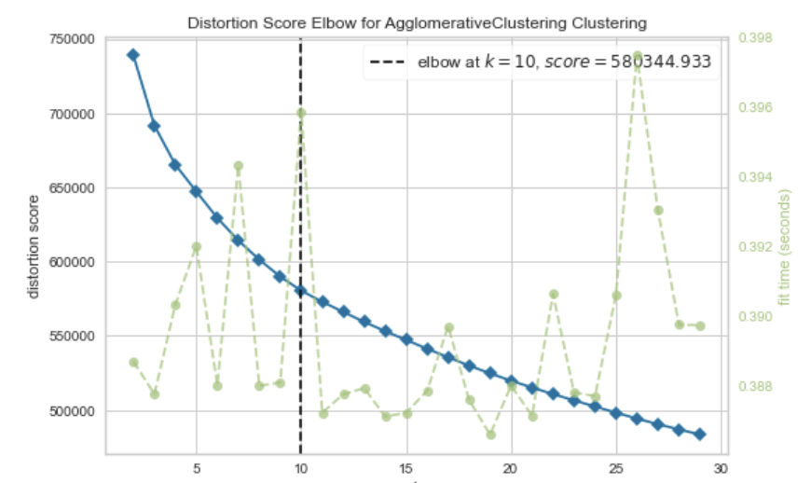
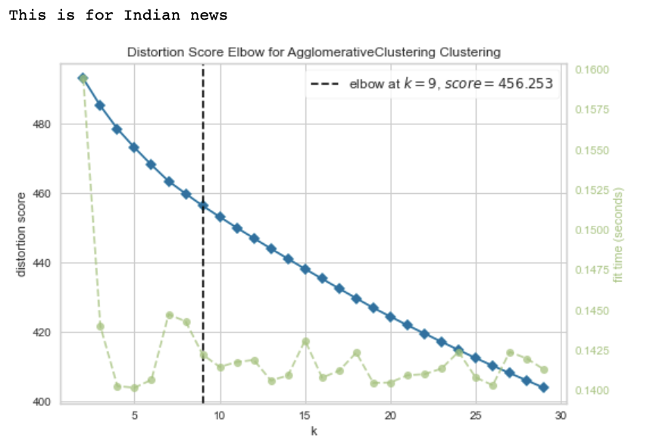
Agglomerative Clustering
With Bag of Words Technique
With TF-IDF Technique
With WordVectors
In Agglomerative clustering with different vectorizers for the Indian news we get 10 , 9 and 9 clusters for bag of words, TF-IDF and WordVectors respectively.​
For American news the same case of Agglomerative clustering with different vectorizers is giving results as 10 , 10 and 9 for bag of words, TF-IDF and WordVectors respectively.

Slide 20
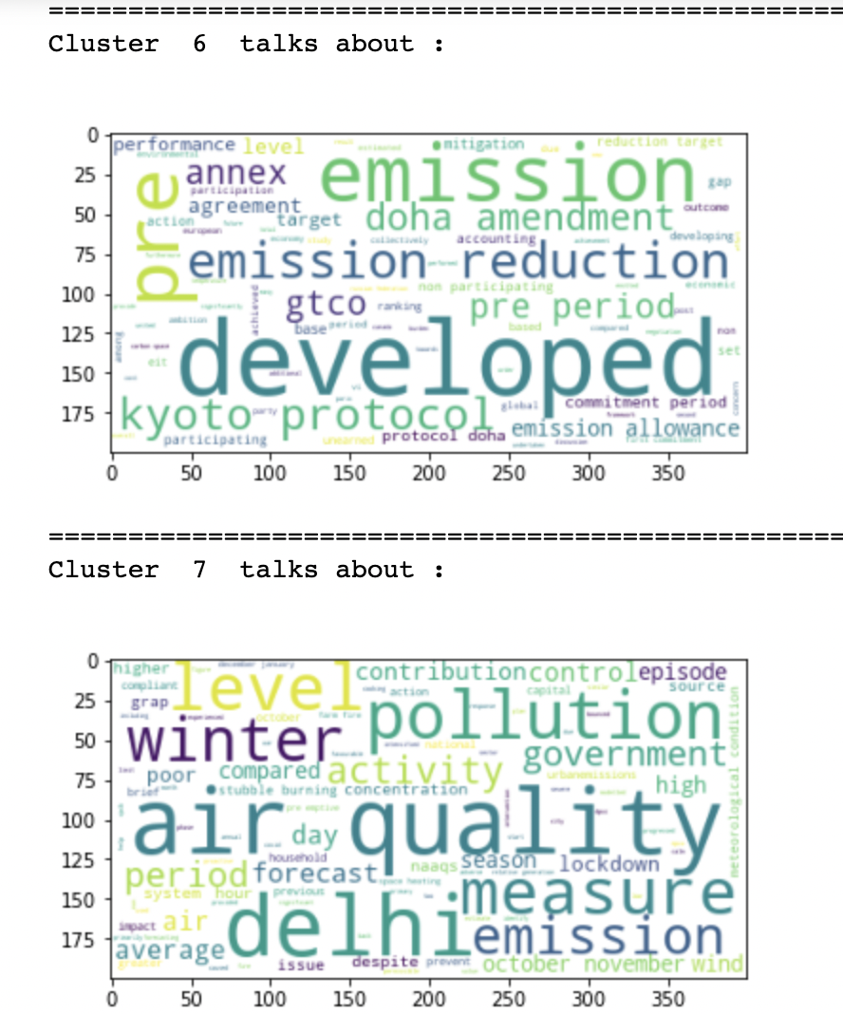
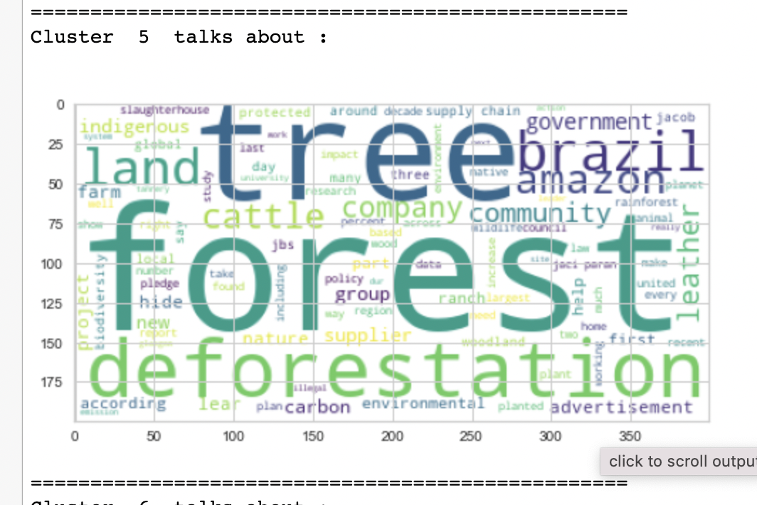
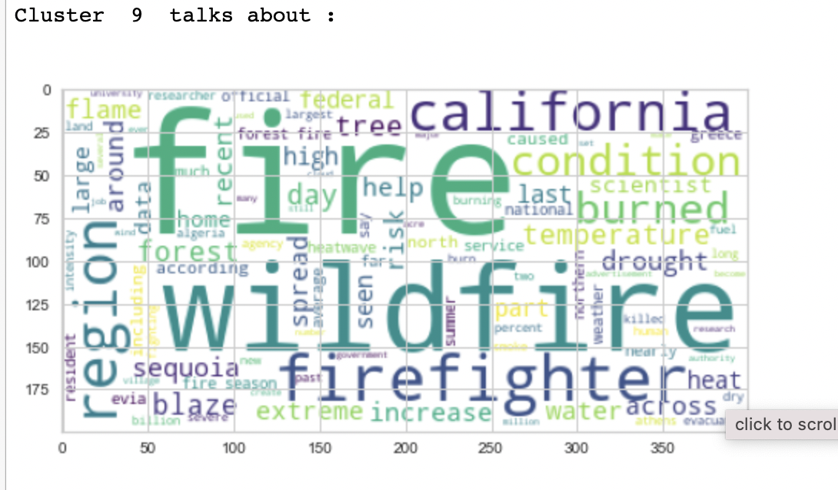
Agglomerative Analysis ...
Indian News American News

Slide 21
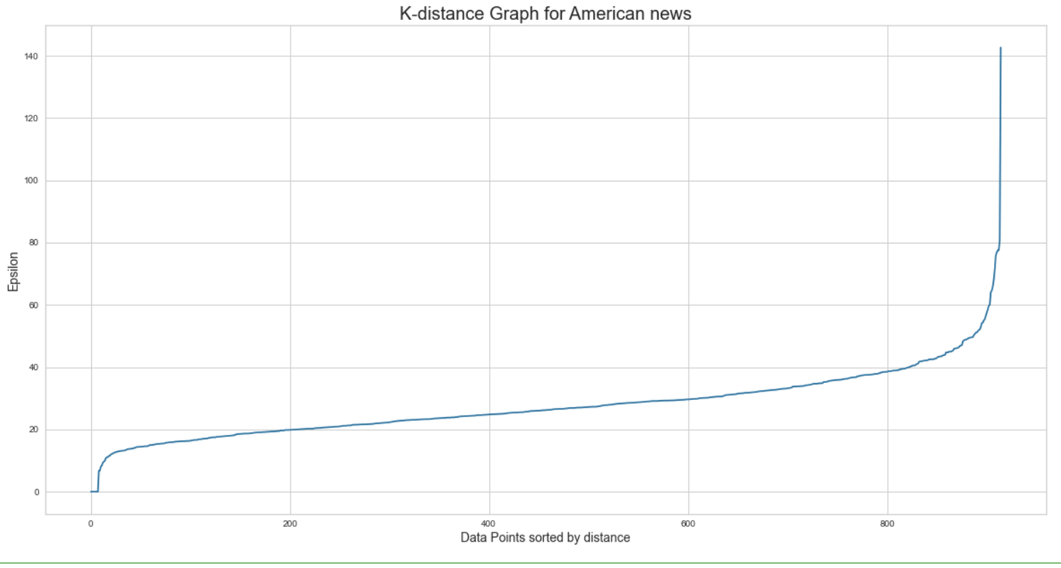
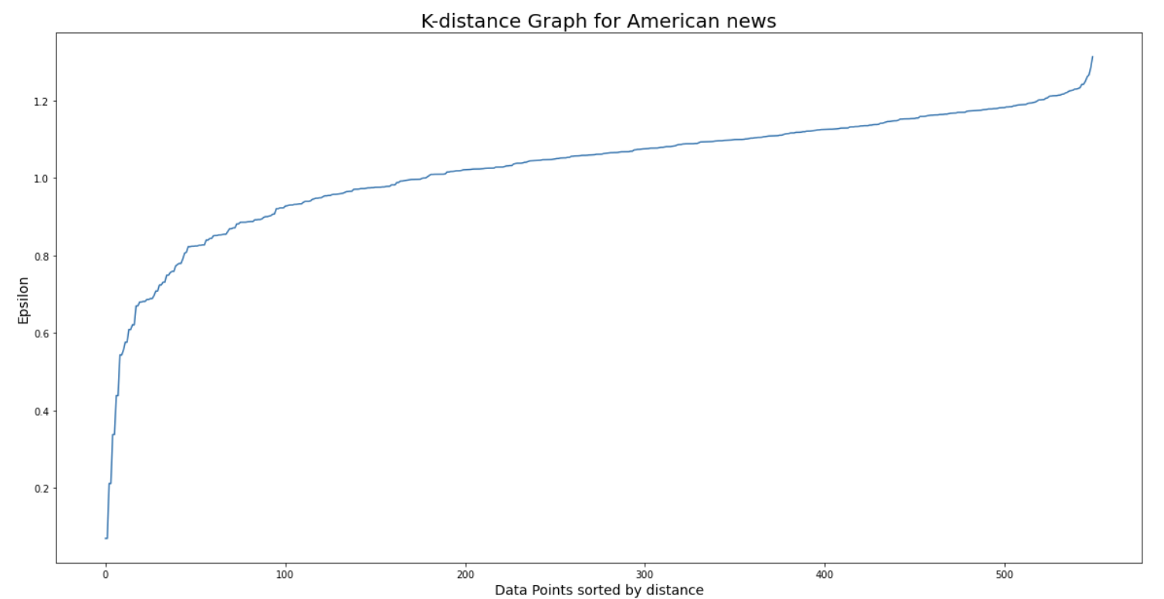
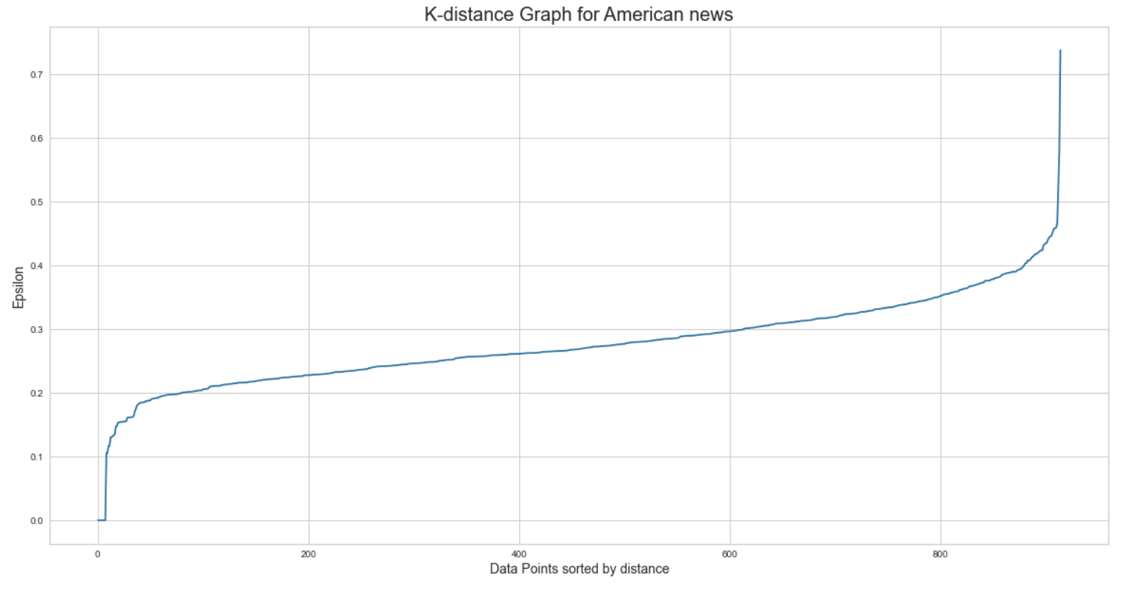
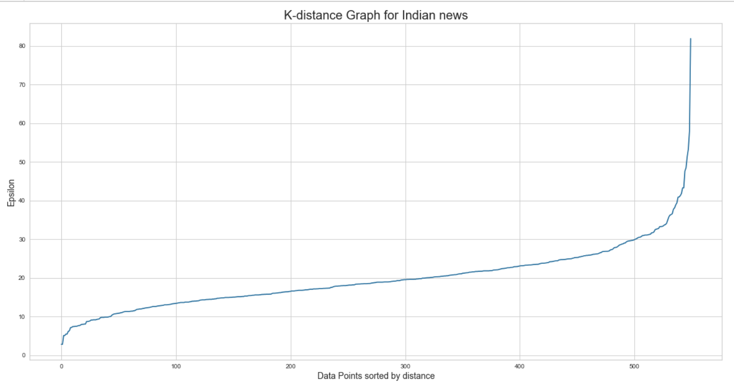
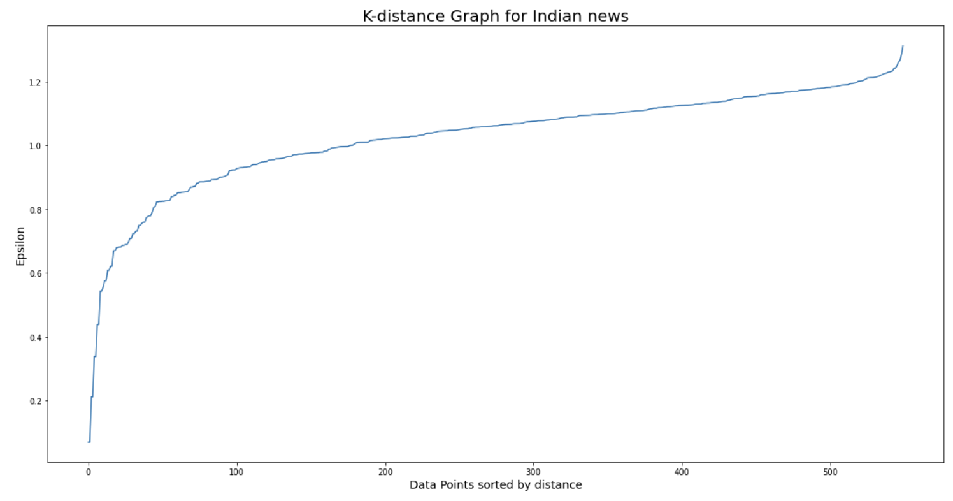
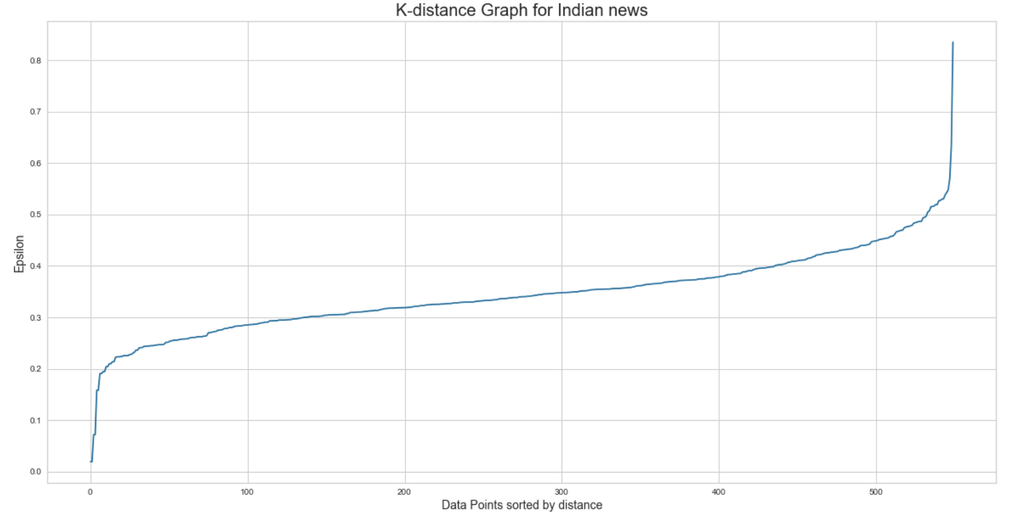
DBSCAN Clustering cont..
With TF-IDF
With Word Vector
With Bag of Words
We used Bag of words, TF-IDF and Word Vector methods with GMM models.​
We performed comparative analysis between Indian and American Newspaper

Slide 22





DBSCAN Analysis ...
Indian News American News

Slide 23

LDA
LDA (Latent Dirichlet Allocation) for topic modelling of the data. . We found out the
best log likelihood and perplexity of the data for (both Indian and American news).We

Slide 24

LDA on Indian News
we create a proper tabulation of top 15 keywords of every topic based on the topic weights of the terms. You can see the results above, above result being for Indian news

Slide 25

LDA on American News

Slide 26


SENTIMENT POLARITY
We have done polarity sentiment visualization of both the datasets using Textblob .
Results of which can be clearly understood by the images below. The polarities
being from –1 to 1 . -1 suggesting negative sentiment and 1 suggesting positive
sentiment.

Slide 27
EVALUATION OF CLUSTERING ALGORITHMS
8 , 9 and 4 are average clusters for Indian news and 8 , 6 and 4 are average
Cluster for American news for bag of words, TF-IDF and WordVectors
respectively.
For Indian news we decide to take an approximate average of 8 clusters for the
Kmeans algorithm .
For American news we take an approximation of 6 clusters for American news
by the mean of these values.
Two types of Evaluation:
Internal Evaluation
External Evaluation(We have just done manual external examination)

Slide 28




Results
Kmeans
GMM
Agglomerative
DBSCAN

Slide 29
Conclusion
We can conclude that various countries have different concerns with the climate
change.
We can observe that developed nations like the US are concerned more
with the carbon emissions, fire etc.
We can notice that tropical counties like India has monsoons, air pollution,forest
Ministry, government, ice levels due to global warming as concerns.
Silhoutte score and Calinski Harabasz score are high when clustered using
KMeans algorithm.
Davies Bouldian score is the lowest for the DBSCAN algorithm.
In the long term, KMeans would be a nice choice to cluster the data related to
climate change.
Thus, this pipeline of using 3 vectorizers for forming clusters with various models
,evaluating the model's cluster's manually, averaging the best cluster values and
performing an internal evaluation analysis with BERT as a vectorizer can be
a good approach to see this not only as a project but as a product for clustering
news articles which various government organisations, companies and news
channels could put to use.
Also we got more negative sentiments for Indian news compared to American
news for a polarity based general analysis of the text using Textblob.

Slide 30
Future Work
We can improve the results more by doing an external evaluation again of all the results of the newly found best algorithms.
We can also use these newly found clusters to manually label the data and do a sentiment analysis of all the data.
We can do a general as well as an indepth emotional sentiment analyis and create a sentiment predicting model ,so we can use this in the industry

Slide 31
Group 11

